Slide 1
Driving Insights: A Comprehensive Analysis of Taxi Operations
Analytics on Wheels
Team Members:
Manoj Velu
Nivethitha Avarampalayam Manoharan
Varshini Vaishnavi Srinivasan

Slide 2
Motivation
How and Why ?!

Slide 3
Introduction
Objectives:
Understand Demand Patterns and Identify Peak Hours.
Analyze Cumulative Revenue Over Time.
Explore RatecodeID and Average Payments.
Understand Customer Payment Preferences.
Impact:
These objectives drive strategic decisions for taxi services, optimizing deployment, rate structures, and customer interactions. The analysis is the compass guiding taxis toward enhanced efficiency and a more customer-centric service.

Slide 4
Data Overview

Slide 5
Field Name | Description
VendorID | A code indicating the TPEP provider that provided the record. 1= Creative Mobile Technologies, LLC; 2= VeriFone Inc.
tpep_pickup_datetime | The date and time when the meter was engaged.
tpep_dropoff_datetime | The date and time when the meter was disengaged.
Passenger_count | The number of passengers in the vehicle. This is a driver-entered value
Trip_distance | The elapsed trip distance in miles reported by the taximeter.
PULocationID | TLC Taxi Zone in which the taximeter was engaged
DOLocationID | TLC Taxi Zone in which the taximeter was disengaged
RateCodeID | The final rate code in effect at the end of the trip. 1= Standard rate 2=JFK 3=Newark 4=Nassau or Westchester 5=Negotiated fare 6=Group ride
Store_and_fwd_flag | This flag indicates whether the trip record was held in vehicle memory before sending to the vendor, aka “store and forward,” because the vehicle did not have a connection to the server. Y= store and forward trip N= not a store and forward trip

Slide 6
Field Name | Description
Payment_type | A numeric code signifying how the passenger paid for the trip. 1= Credit card 2= Cash 3= No charge 4= Dispute
Fare_amount | The time-and-distance fare calculated by the meter
Extra | Miscellaneous extras and surcharges. Currently, this only includes the $0.50 and $1 rush hour and overnight charges.
MTA_tax | $0.50 MTA tax that is automatically triggered based on the metered rate in use
Improvement_surcharge | $0.30 improvement surcharge assessed trips at the flag drop. The improvement surcharge began being levied in 2015.
Tip_amount | Tip amount – This field is automatically populated for credit card tips. Cash tips are not included.
Tolls_amount | Total amount of all tolls paid in trip.
Total_amount | The total amount charged to passengers. Does not include cash tips.

Slide 7
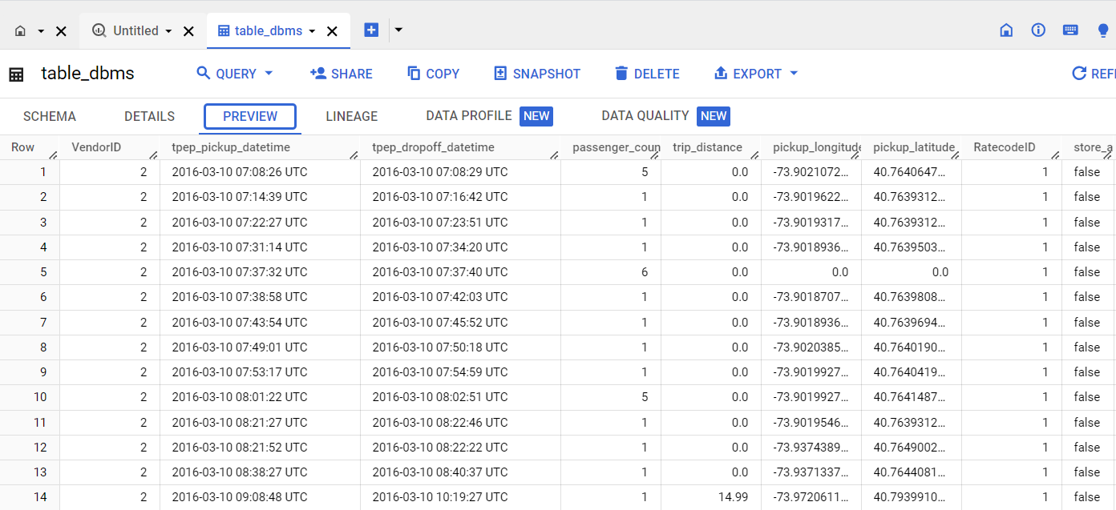

Slide 8
ETL

Slide 9
Extract (E):
Authenticating the user, downloading dataset, and listing files in Google Drive.

Slide 10
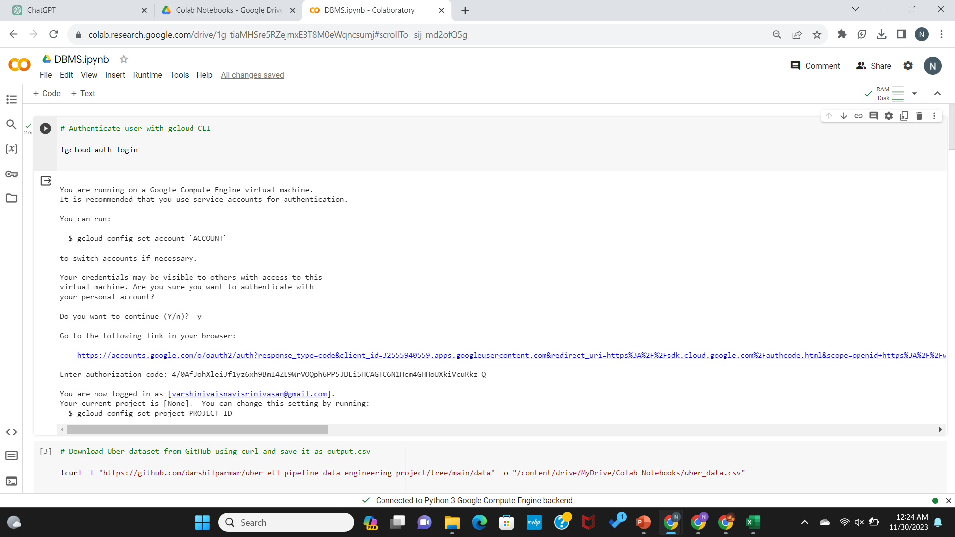

Slide 11
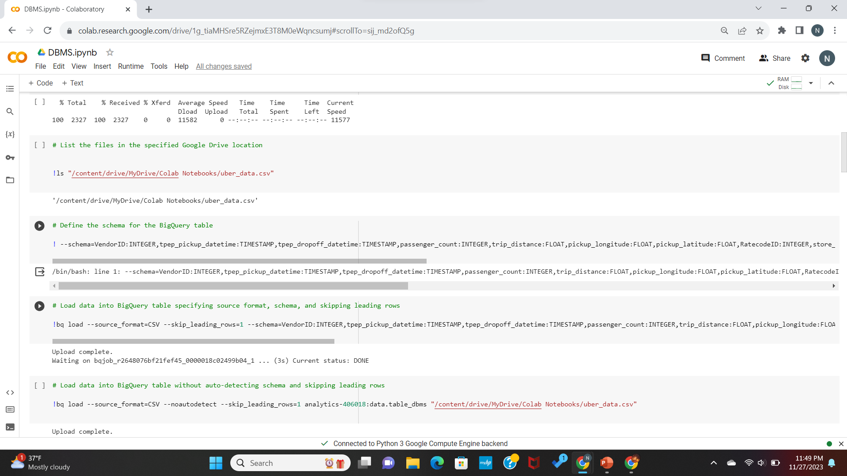

Slide 12
Transform (T):
Defining the schema for the BigQuery table and loading data into BigQuery with specified configurations.

Slide 14
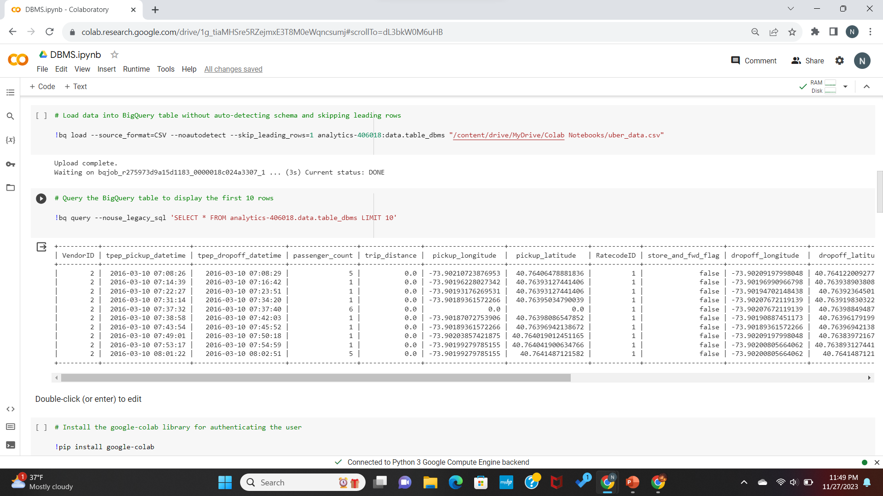

Slide 15
Load (L):
Running queries on the loaded data and setting up necessary dependencies and authentication for Google Cloud services.

Slide 16
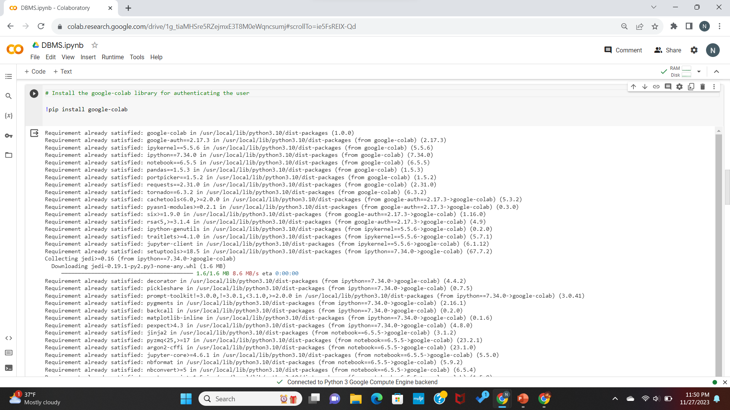

Slide 17
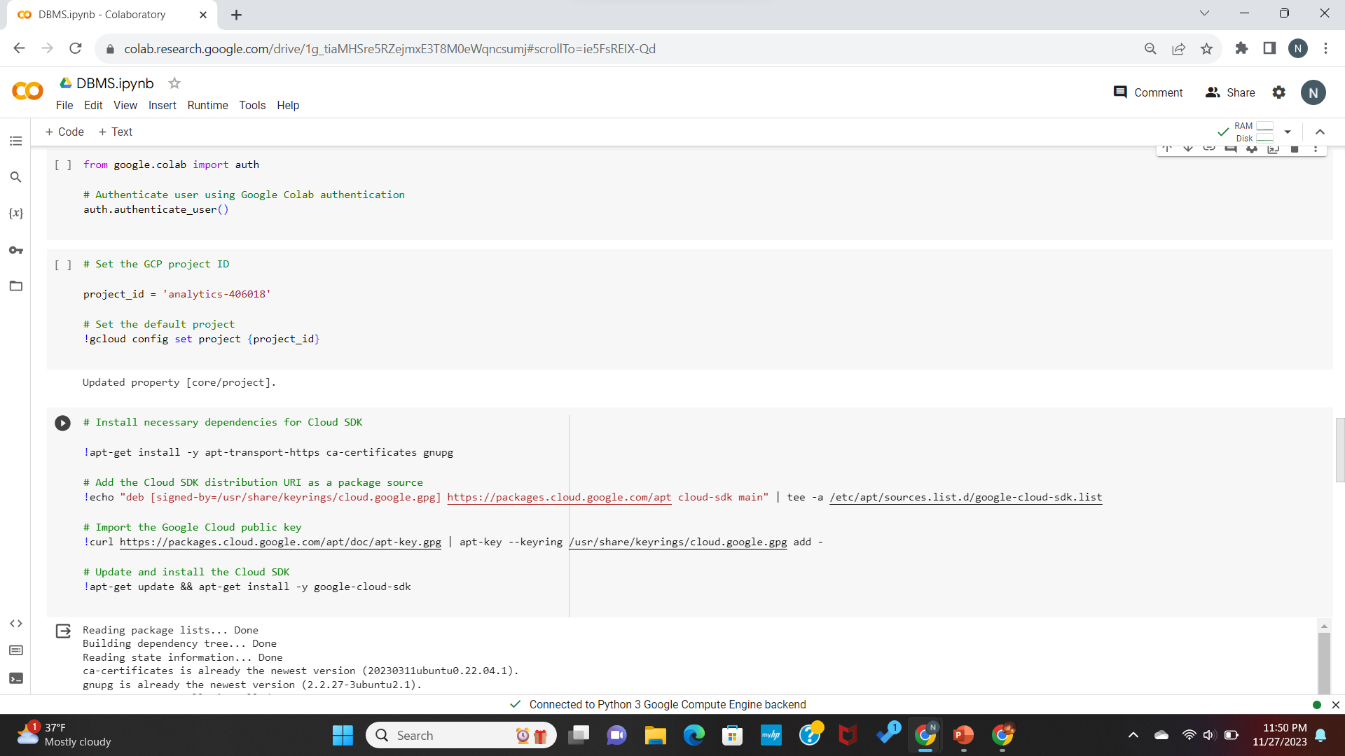

Slide 18
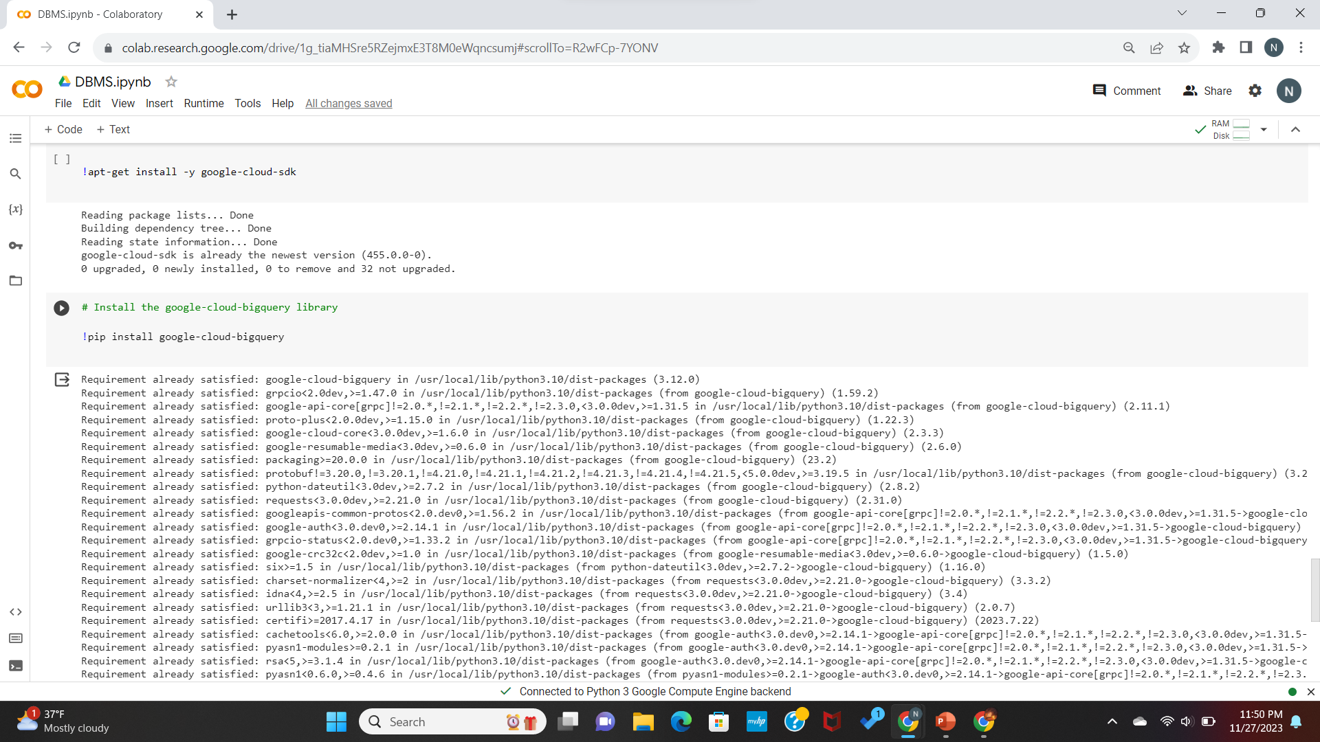

Slide 19
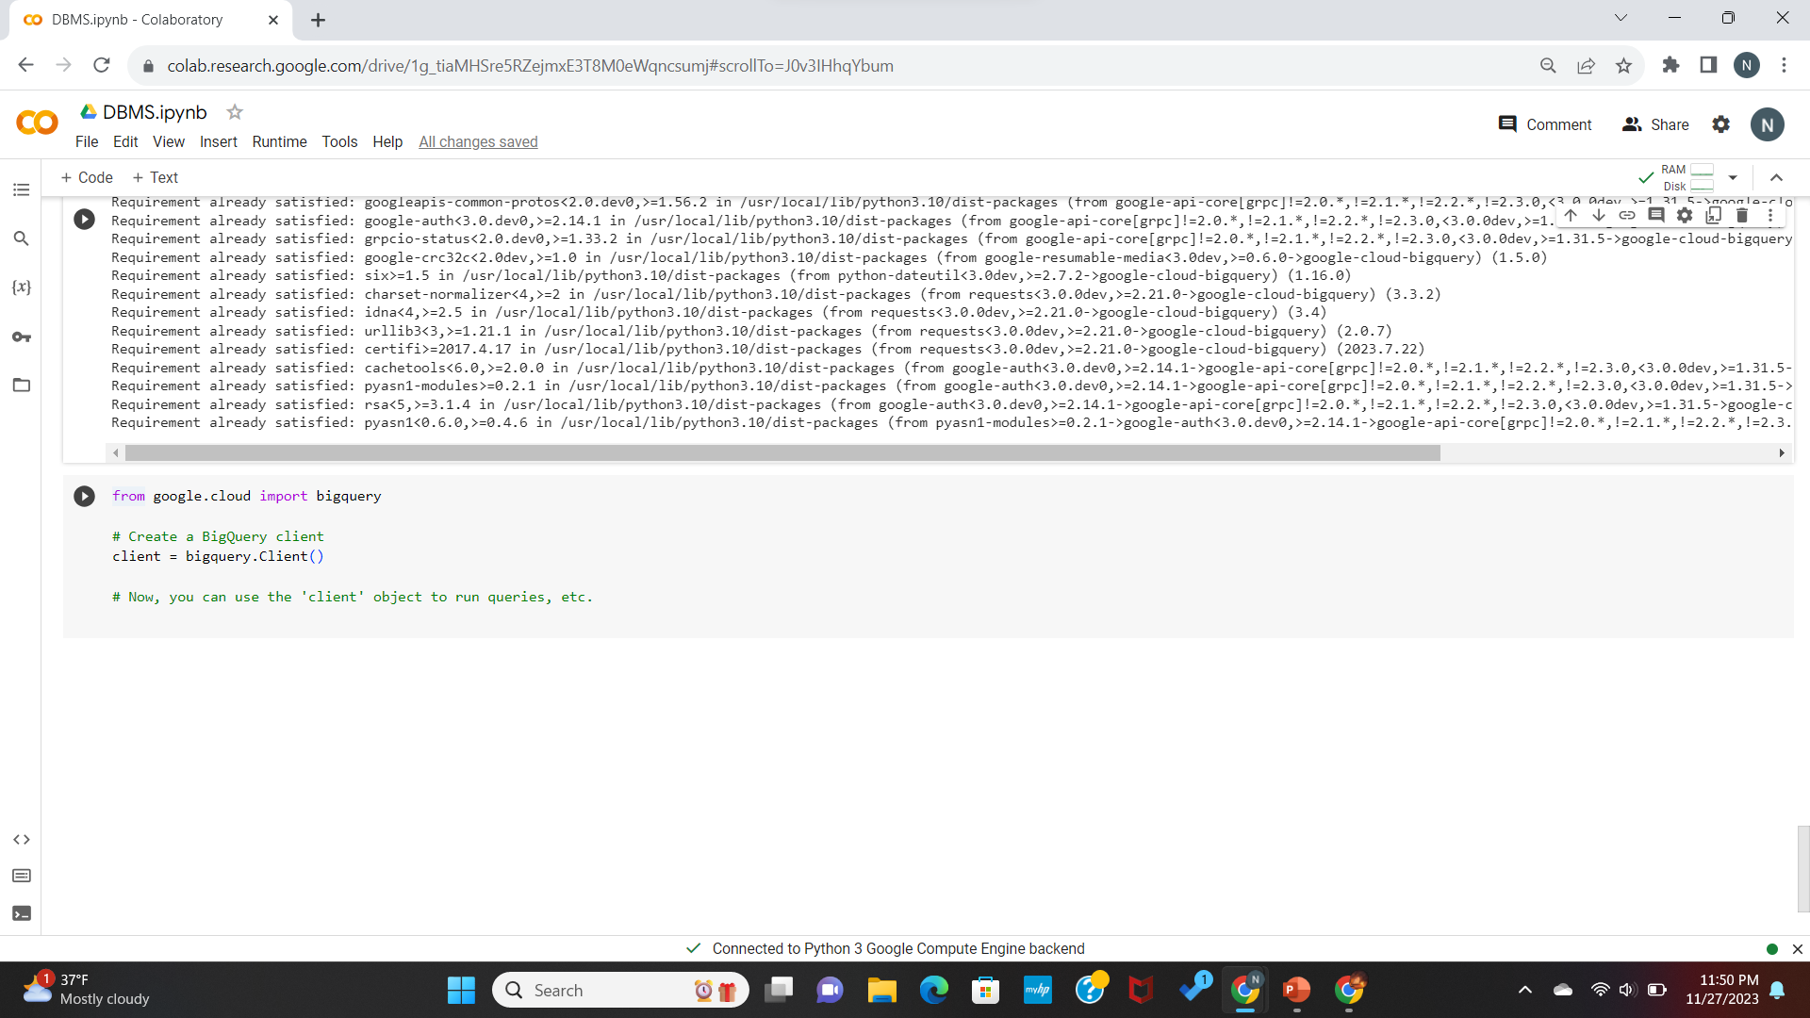

Slide 20
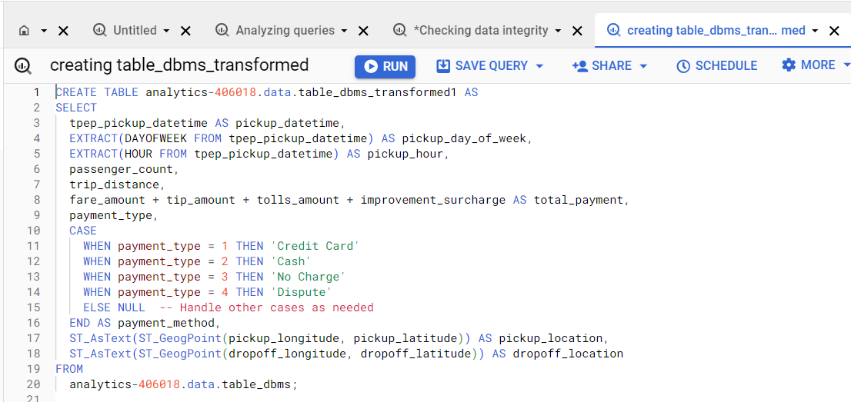

Slide 21
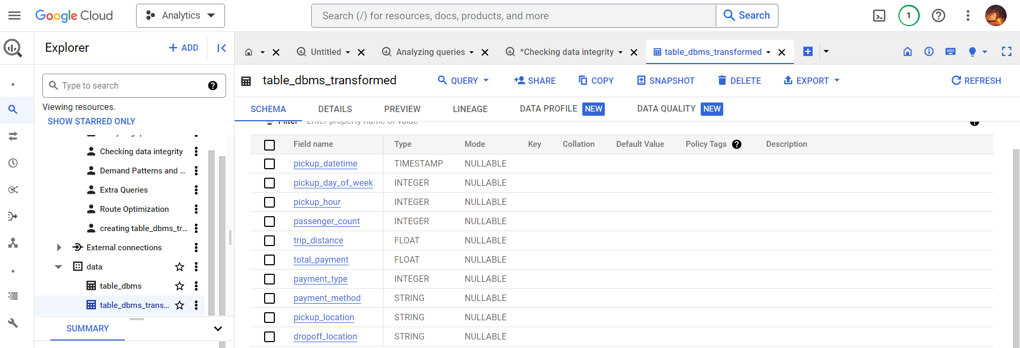

Slide 22
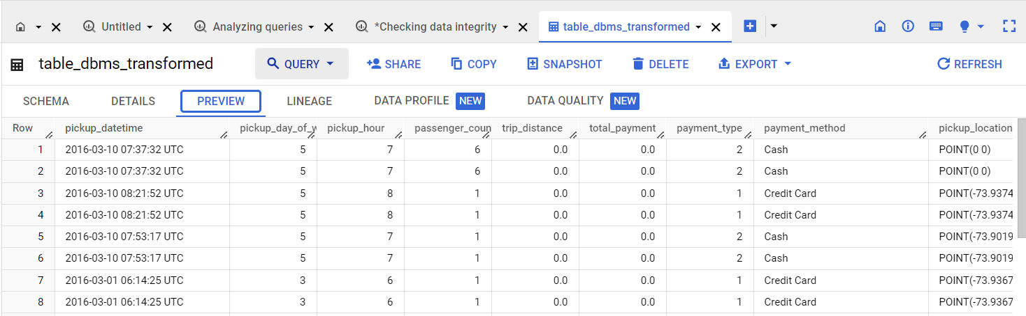

Slide 23
Data Validation

Slide 24
Null Values:
Checked for null values in columns.
No null values found in the dataset.
Data Types:
Verified data types for columns.
Ensured that data types align with expectations.

Slide 25
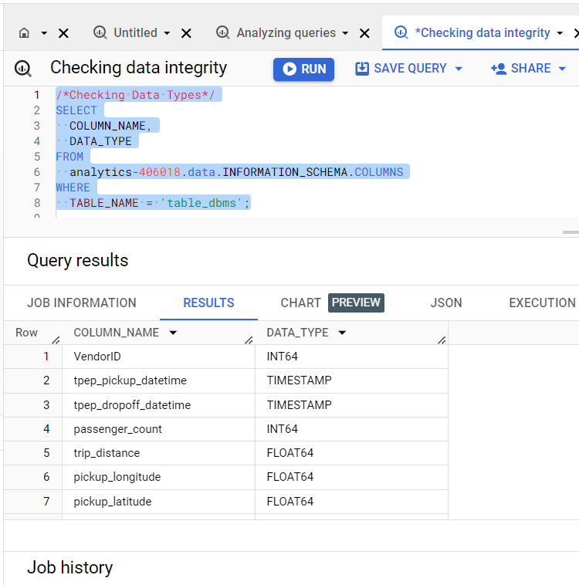

Slide 26
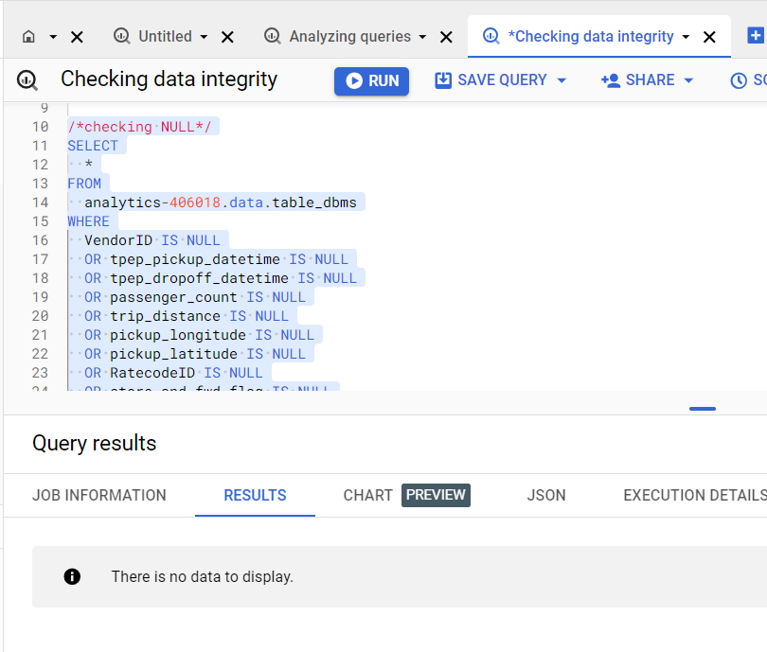

Slide 27
Data Analysis and Insights

Slide 28
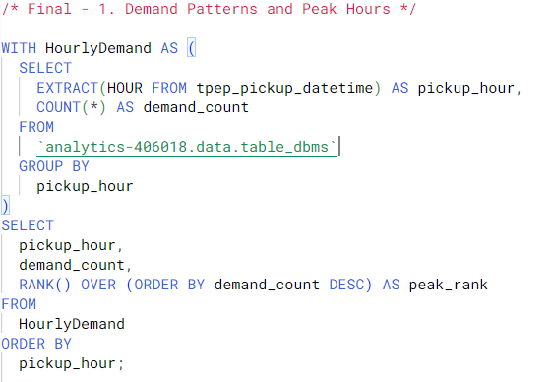
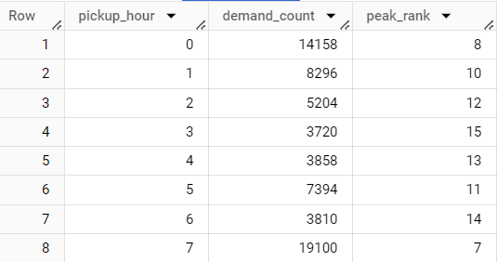
1. Demand Pattern and Peak Hours:

Slide 29
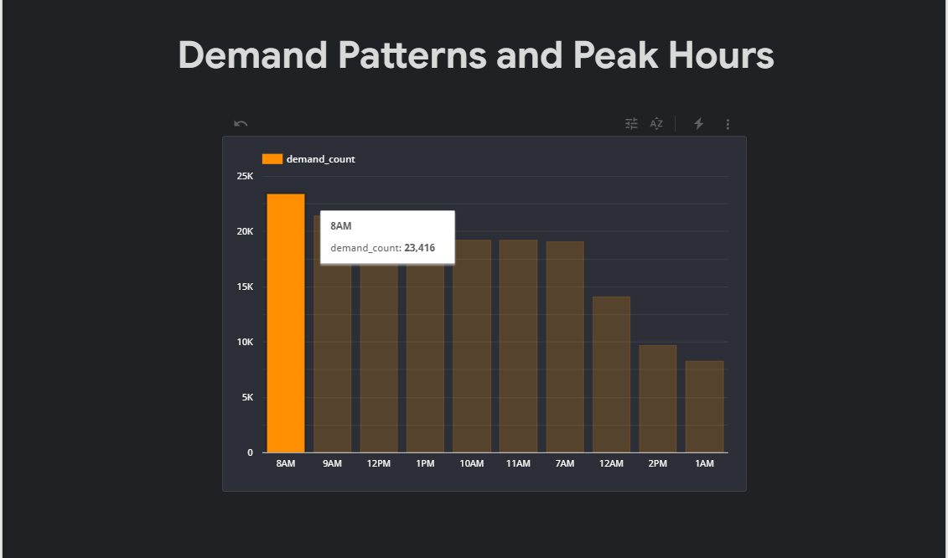
Demand Pattern and Peak Hours:

Slide 30
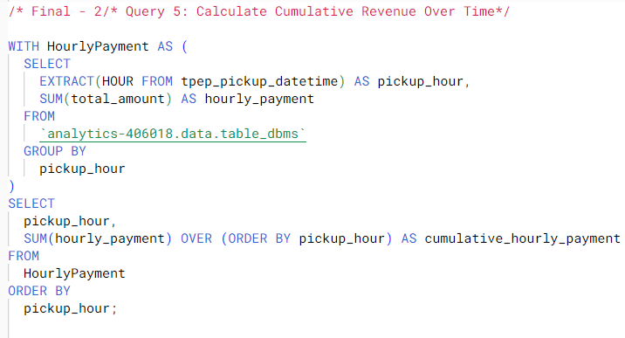
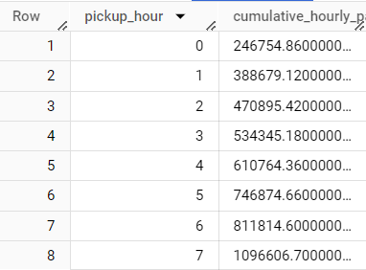
2. Cumulative Revenue Over Time :

Slide 31
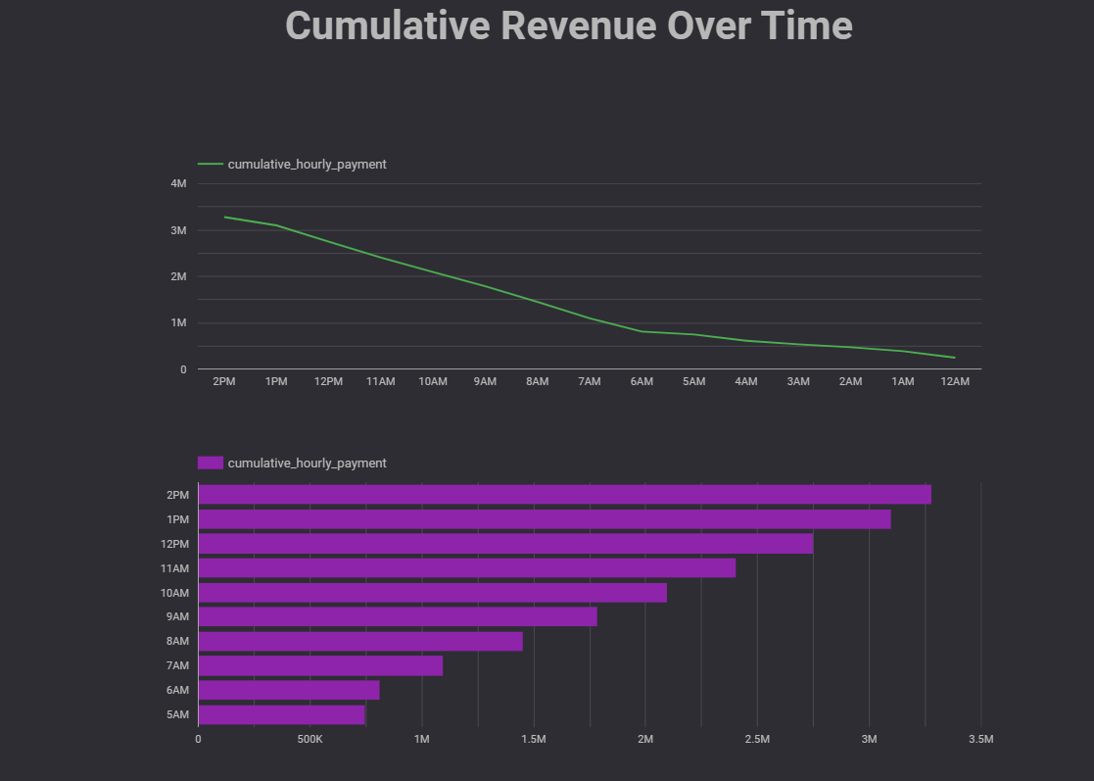

Slide 32
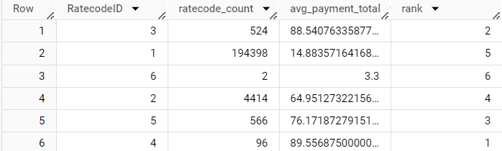
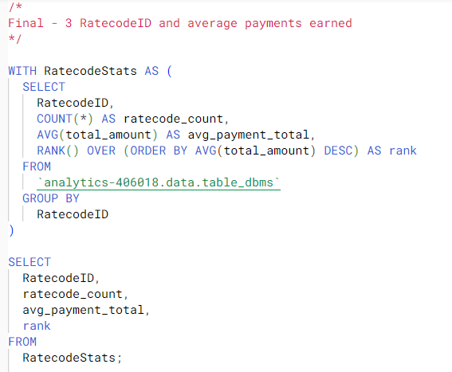
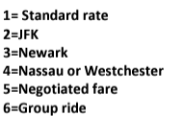
3. Rate code Statistics:

Slide 33
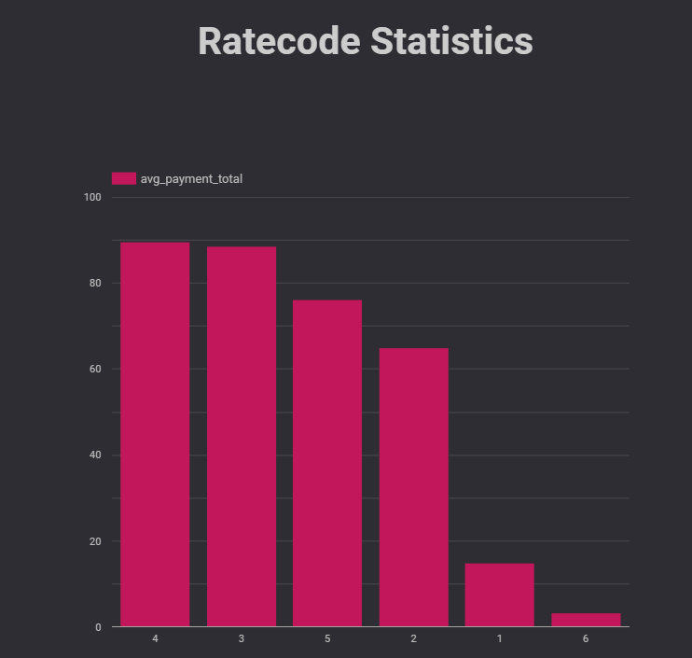

Slide 34
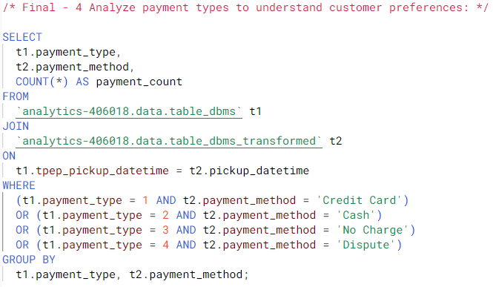
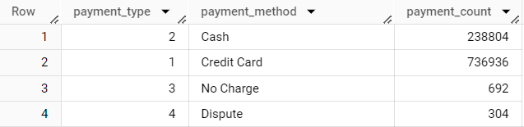
4. Payment Preference:

Slide 35
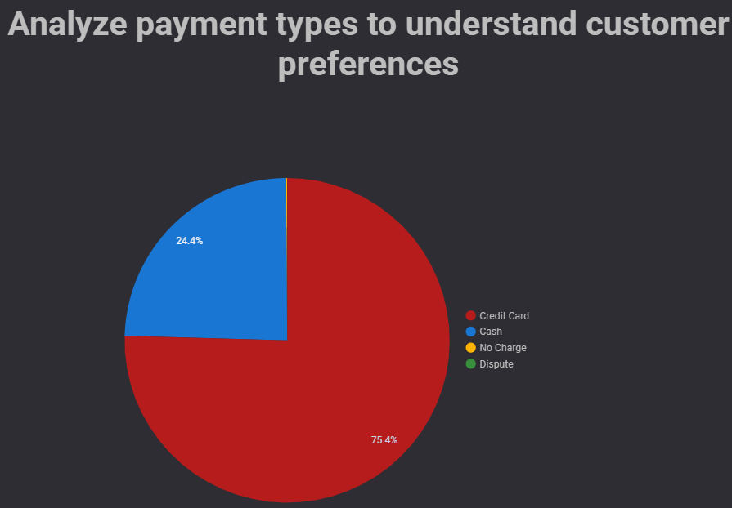

Slide 36
Recommendations

Slide 37
Fleet Optimization for Peak Demand
Capitalizing on Business Hour Opportunities
Strategic Resource Allocation
Targeted Marketing for High-Average Rate Codes
Optimization of Low-Performing Rate Codes
Enhancing Digital Payment Infrastructure
Encouraging Cash and Card Flexibility
Reviewing No Charge Instances
Effective Dispute Resolution

Slide 38
Conclusion
We have extracted the dataset and leveraged GCP and its tools to run queries that give us a bigger picture about the dataset
This analysis provides some key insights for taxi services to excel in operational demands, revenue generation, and customer satisfaction.
Leveraging these insights can ensure a thriving future in the competitive transportation industry by exceeding customer expectations.

Slide 39
References
https://www.nyc.gov/site/tlc/about/tlc-trip-record-data.page
https://www.nyc.gov/assets/tlc/downloads/pdf/data_dictionary_trip_records_yellow.pdf
https://github.com/darshilparmar/uber-etl-pipeline-data-engineering-project/blob/main/README.md

Slide 40
Thank You

